Slide 1
A Causal Map of Reduced Readmission Rates
Built by Domain Experts

Slide 2
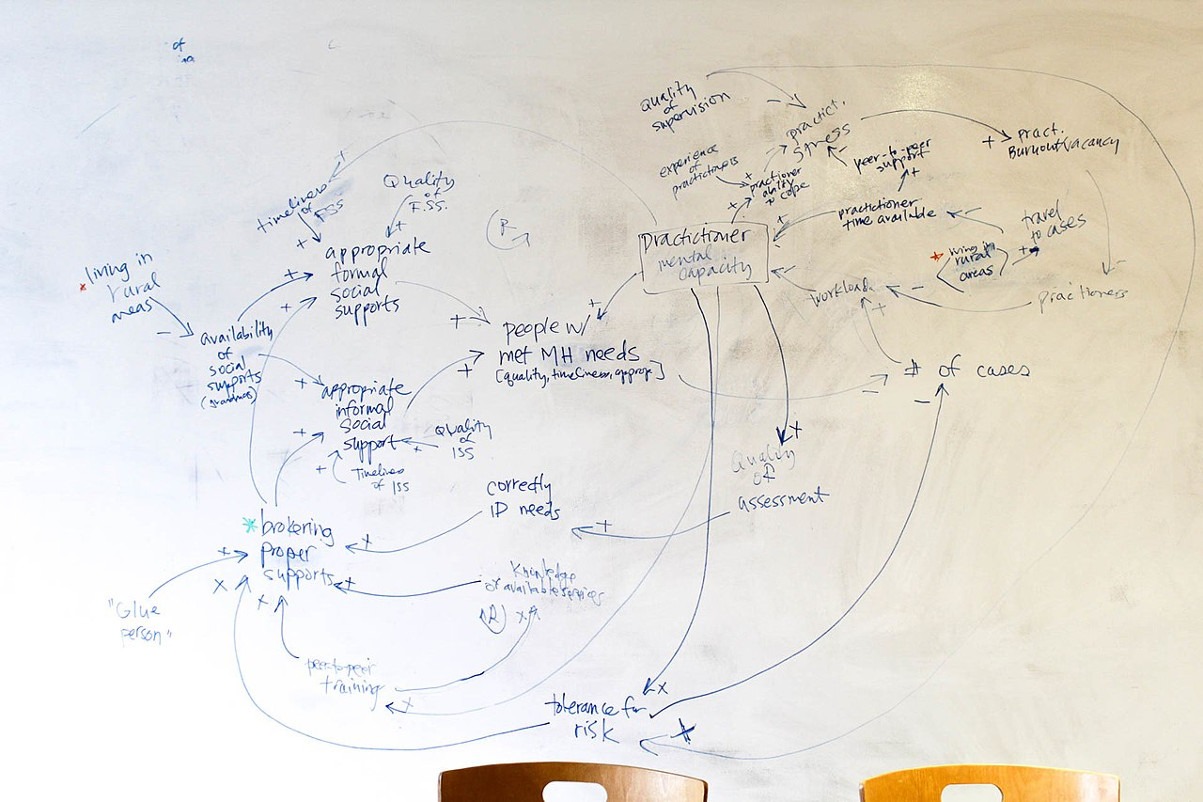
Goal of Causal Mapping
How to make one:
List many factors that cause (+) or prevent (-) an outcome X.
Draw causal relationships among factors and between the factors and the outcome.
How to use one:
Look for reinforcing loops (vicious or virtuous cycles) as an ideal place to intervene.
For machine-learning driven modeling:
Identify a large set of factors
Identify actionable factors
Identify factors by causal precedence

Slide 3
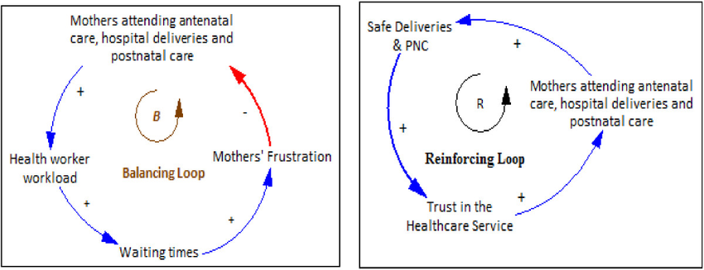
Goal of Causal Mapping
How to make one:
List many factors that cause (+) or prevent (-) an outcome X.
Draw causal relationships among factors and between the factors and the outcome.
How to use one:
Look for reinforcing loops (vicious or virtuous cycles) as an ideal place to intervene.
For machine-learning driven modeling:
Identify a large set of factors
Identify actionable factors
Identify factors by causal precedence

Slide 4
Goal of Causal Mapping
How to make one:
List many factors that cause (+) or prevent (-) an outcome X.
Draw causal relationships among factors and between the factors and the outcome.
How to use one:
Look for reinforcing loops (vicious or virtuous cycles) as an ideal place to intervene.
For machine-learning driven modeling:
Identify a large set of factors
Identify actionable factors
Identify factors by causal precedence

Slide 5
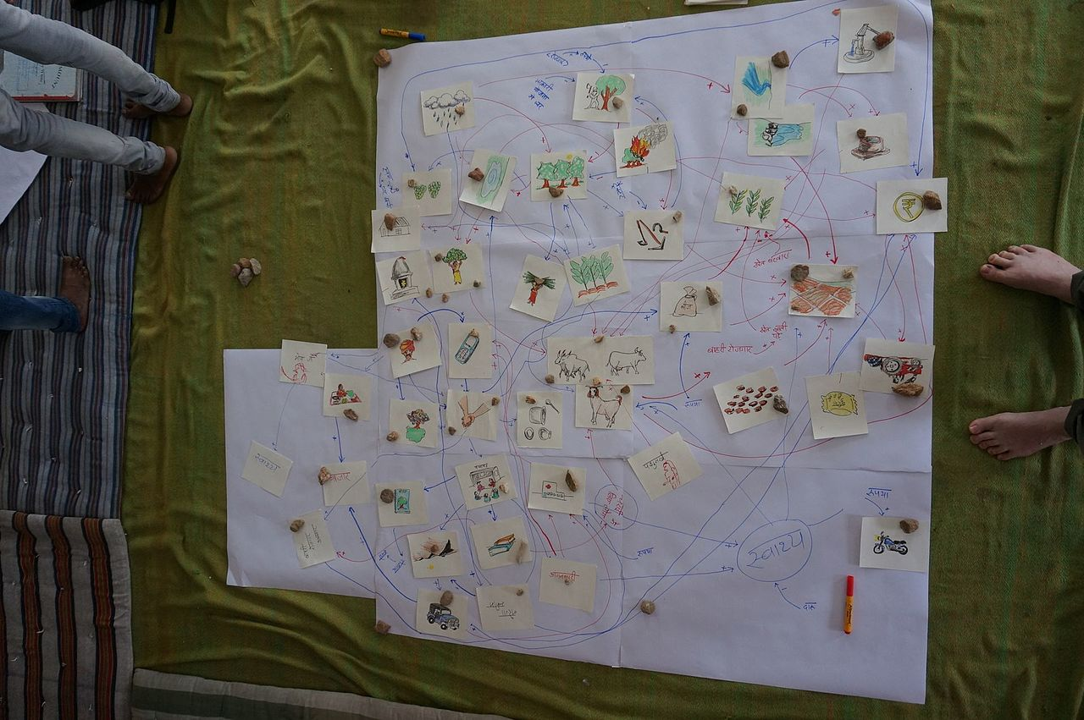
Causal mapping is versatile

Slide 6
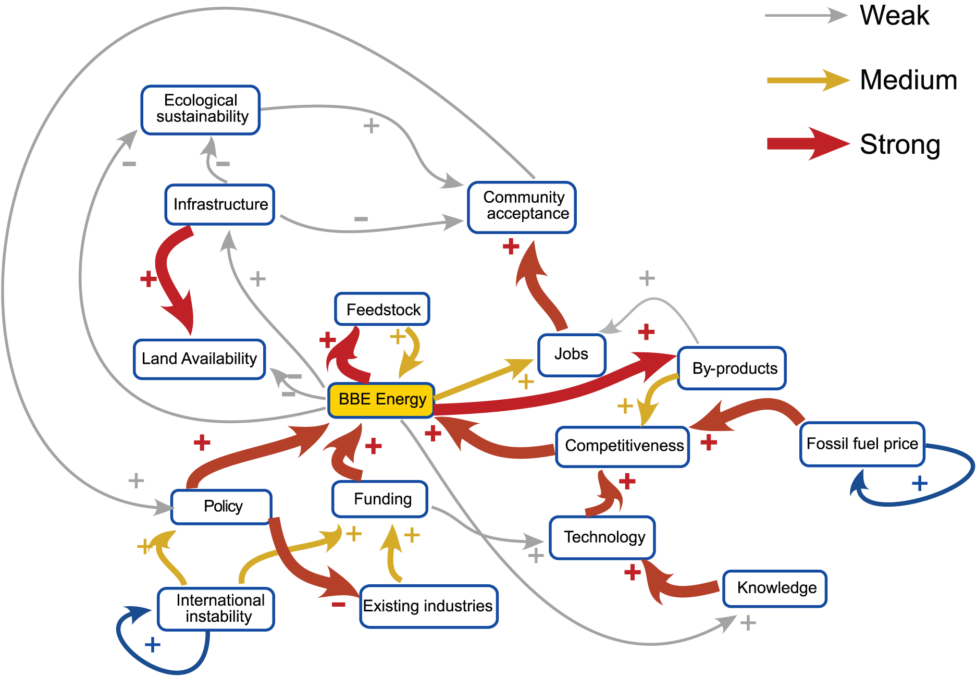
Causal mapping is versatile

Slide 7
Today’s task
List every conceivable factor that increases or reduces readmission rates.
Focus on an adult male patient with primary heart failure index admission. What affects (+ or -) his readmission?
Across all causes of hospital admission (and both genders, all ages), which Dx have similar causal maps to HF?
Group Dx into sets with similar causal maps.
In the future:
Draw causal arrows
Identify factors that can be acted upon
Identify feedback loops

